Slide 1
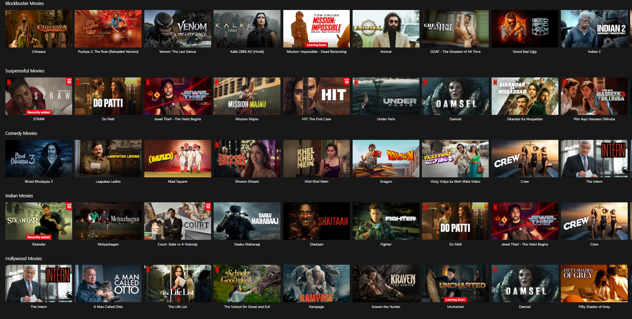


Mini Netflix:
Movie Recommendation System
Python
Streamlit
Pandas
Scikit-learn
TF-IDF
Cosine Similarity
Streamlit Cloud
Presented by
Nayab Rasool Shaik

Slide 2
Project Overview
A beginner-friendly Movie Recommendation System
Uses both Collaborative & Content-based Filtering
Built with Python and deployed using Streamlit Cloud
Enhanced with tags and IMDB redirection

Slide 3
Objective
Help users find movies similar to ones they love
Use user rating patterns and movie metadata
Provide recommendations with clickable IMDB links
Make it interactive via a web app (Streamlit)

Slide 4
Dataset Description
Dataset: MovieLens Latest Small Dataset
Files Used:
movies.csv : Movie titles and genres
ratings.csv : User-movie rating matrix
tags.csv : User-generated tags (for TF-IDF)
links.csv : Maps movieId to IMDB and TMDb IDs

Slide 5
Tech Stack
Frontend: Streamlit
Backend: Python (Pandas, Scikit-learn)
ML: Cosine Similarity, TF-IDF
Deployment: Streamlit Cloud
Extras: IMDB Links, HTML Styling

Slide 6

Folder Structure
movie_recommender_app/
├── app.py
├── utils/
│ └── recommender.py
├── data/
│ ├── movies.csv
│ ├── ratings.csv
│ ├── tags.csv
│ └── links.csv
├── assets/
│ ├── backgroundimg.webp
│ └── style.css
├── requirements.txt
└── README.md

Slide 7
Recommendation Logic
Hybrid Recommendation >>> Collaborative + Content
Ratings matrix >>> Cosine similarity (user behavior)
Tags vectorization >>> TF-IDF similarity (content)
Combine both scores for hybrid ranking

Slide 8
Recommendation Output
Top 5 movies similar to input
Displayed as clickable movie titles
Opens in new tab with IMDB link
Styled using injected HTML + CSS

Slide 9
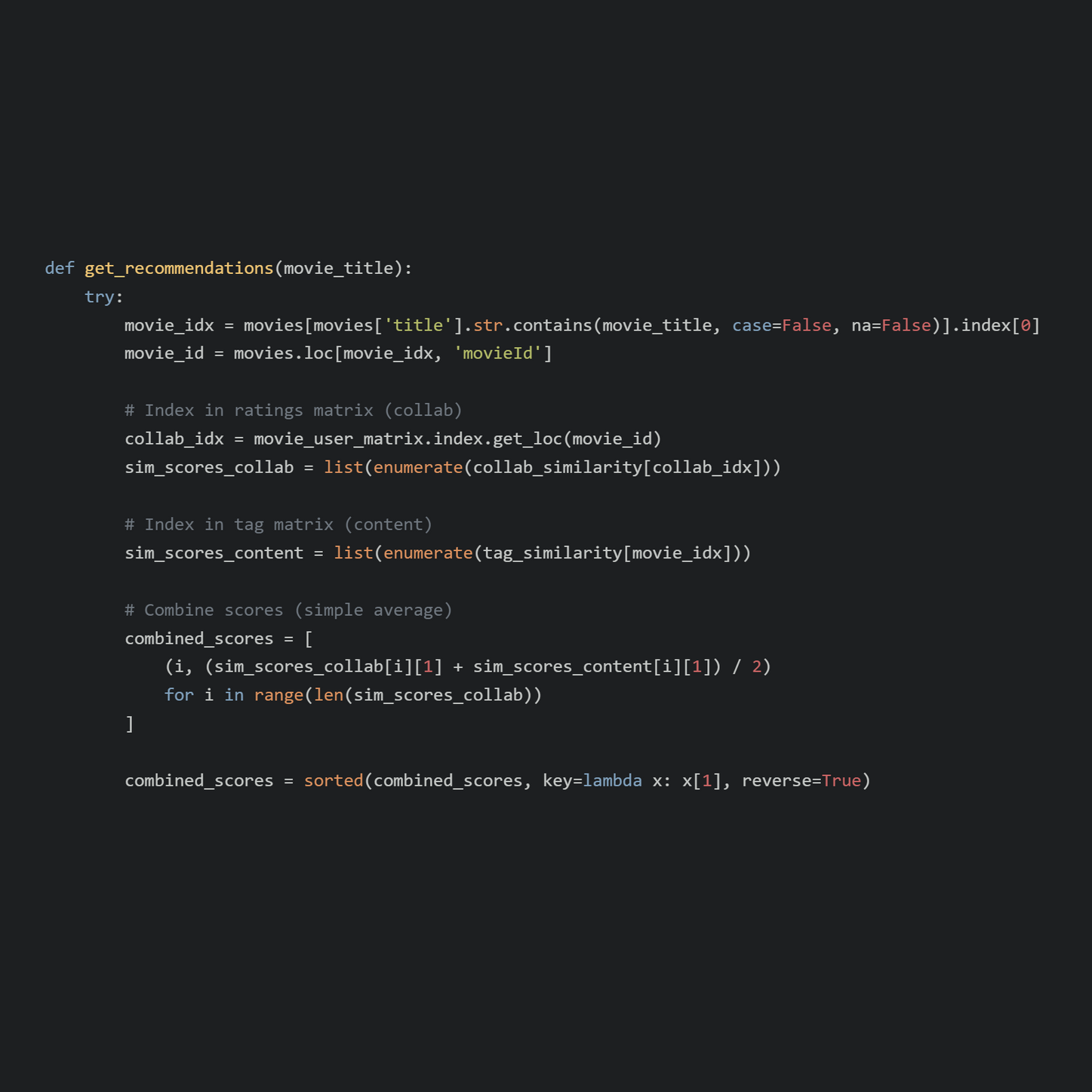
Code Snippet: Recommendation Function

Slide 10
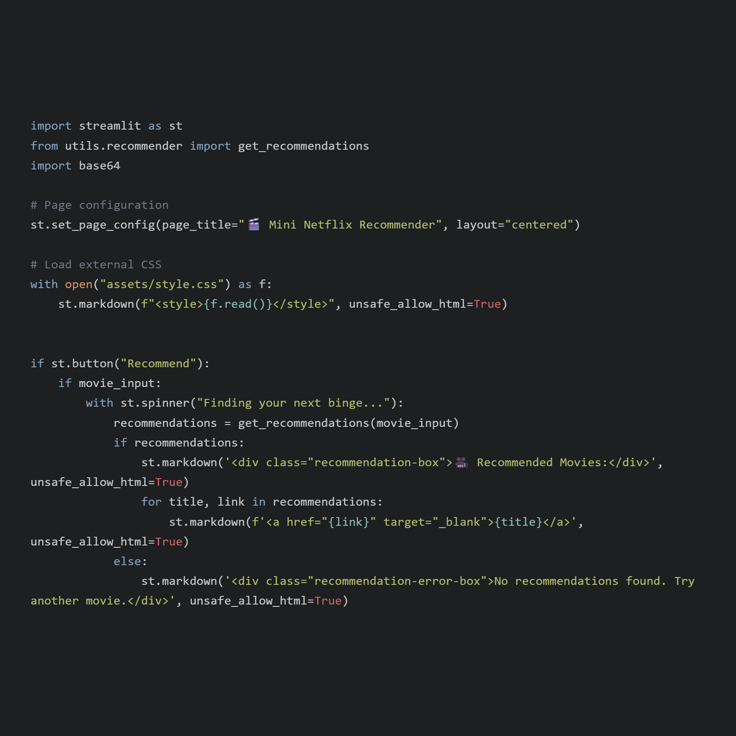
Code Snippet: Streamlit App

Slide 11
Deployment Steps
Push project to GitHub
Go to streamlit.io/cloud
Connect repo and deploy app.py
Add secret keys if needed(present no need)
Share public Streamlit app URL

Slide 12

Future Enhancements
Show TMDb posters next to titles
Add genre filtering dropdown
Add search history or watchlist
Use explicit feedback (like/dislike)

Slide 13
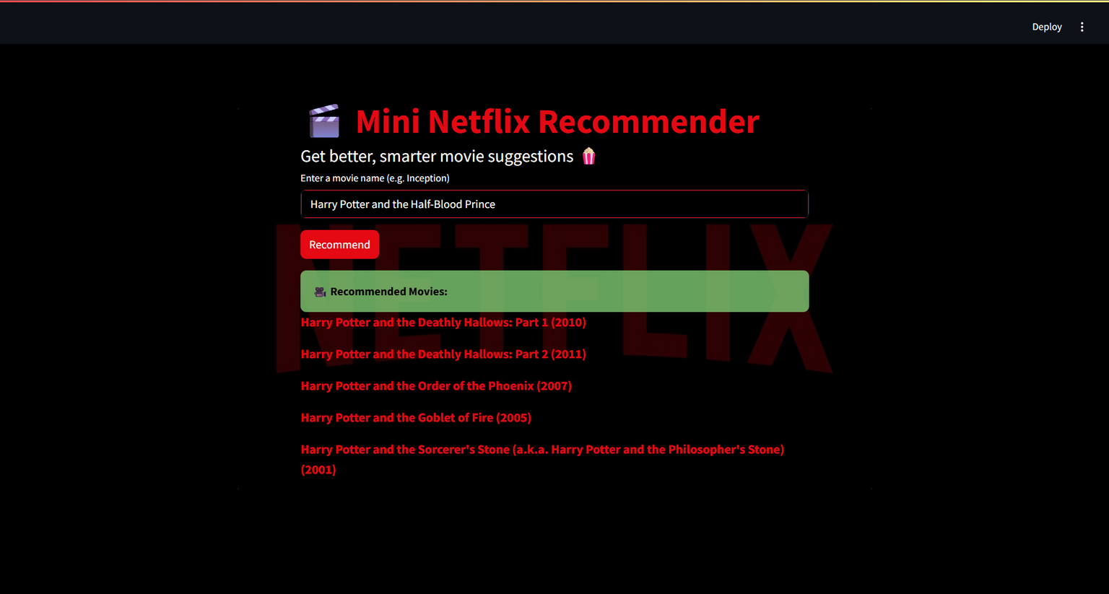
Demo Screenshot

Slide 14
Summary
Functional, Interactive Movie Recommender
Combines content + collaborative filtering
Deployed using Streamlit Cloud
Beginner-friendly, scalable project

Slide 15

Thank You
Connect with Me
Linkedin: @nayabrasool-shaik
Github: NayabRasool786

